Slide 1
CS61065: Theory and Applications of Blockchain
Basic Crypto Primitives - I
Shamik Sural
shamik@cse.iitkgp.ac.in

Slide 2
What You’ll Learn
Basic cryptographic primitives behind the blockchain technology
Cryptographically Secure Hash Function
Digital Signature
Hash Function: Used to connect the “blocks” in a “chain” in a tamper-proof way
Digital Signature: Digitally sign the data so that no one can “deny” about their own activities. Also, others can check whether it is authentic.

Slide 3
Cryptographic Hash Functions
Takes any arbitrarily sized string as input
Input M: The message
Fixed size output (We use 256 bits in Blockchain)
Output H(M): We call this as the message digest
Efficiently computable

Slide 4
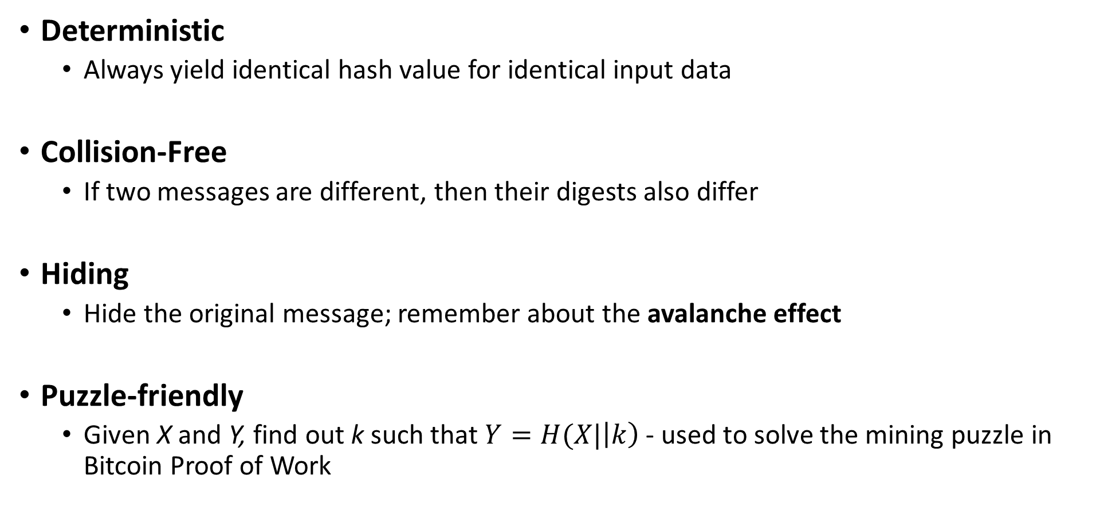
Cryptographic Hash Function: Properties
Deterministic
Always yield identical hash value for identical input data
Collision-Free
If two messages are different, then their digests also differ
Hiding
Hide the original message; remember about the avalanche effect
Puzzle-friendly
Given X and Y, find out k such that $Y=H(X|\left|k\right)$ - used to solve the mining puzzle in Bitcoin Proof of Work

Slide 5
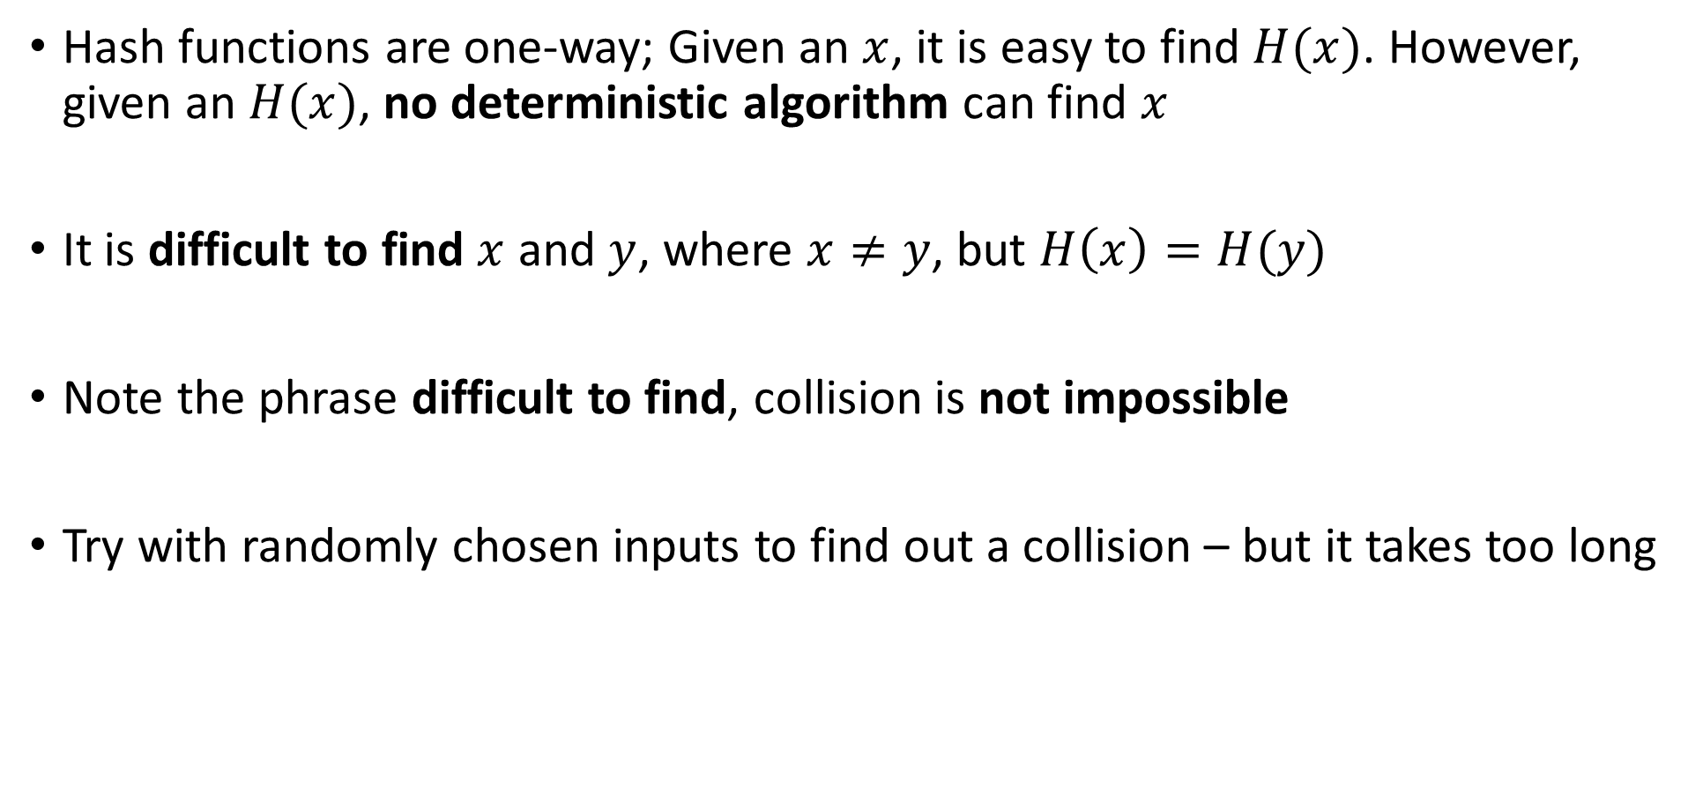
Collision Free
Hash functions are one-way; Given an $x$, it is easy to find $H(x)$. However, given an $H(x)$, no deterministic algorithm can find $x$
It is difficult to find $x$ and $y$, where $x≠y$, but $H\left(x\right)=H(y)$
Note the phrase difficult to find, collision is not impossible
Try with randomly chosen inputs to find out a collision – but it takes too long

Slide 6
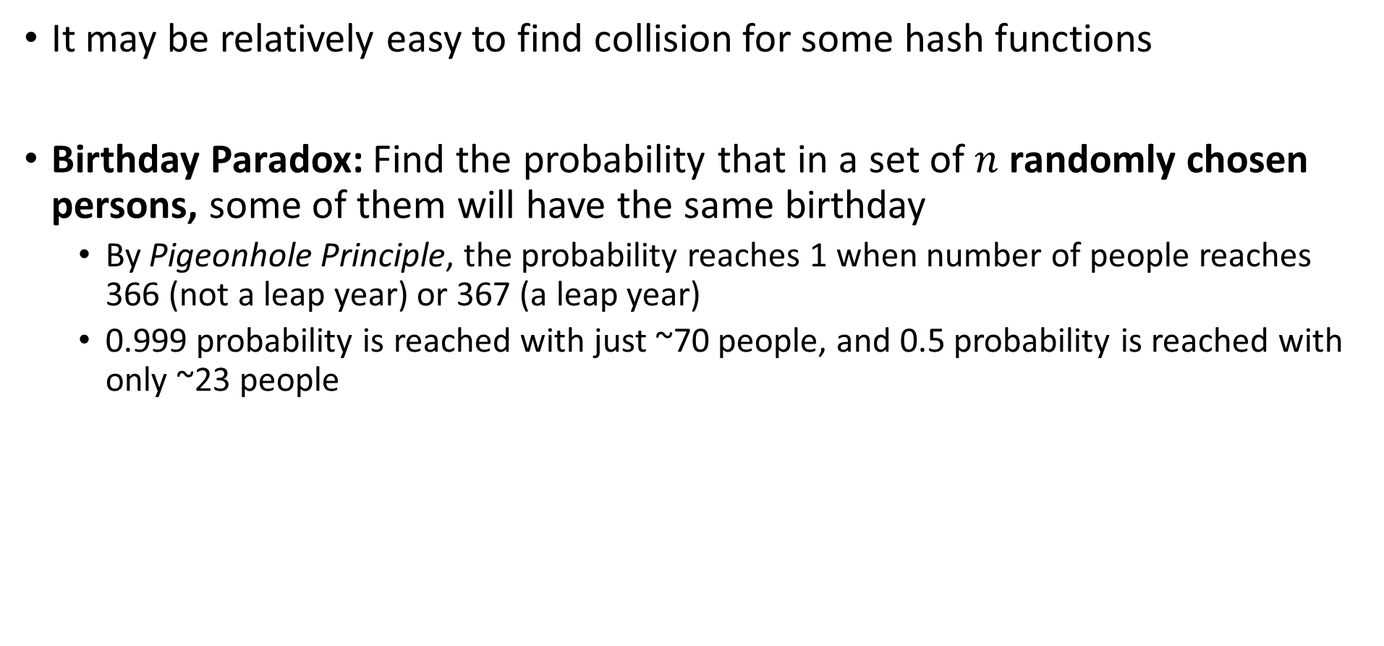
Collision Free – How Do We Guarantee
It may be relatively easy to find collision for some hash functions
Birthday Paradox: Find the probability that in a set of $n$ randomly chosen persons, some of them will have the same birthday
By Pigeonhole Principle, the probability reaches 1 when number of people reaches 366 (not a leap year) or 367 (a leap year)
0.999 probability is reached with just ~70 people, and 0.5 probability is reached with only ~23 people

Slide 7
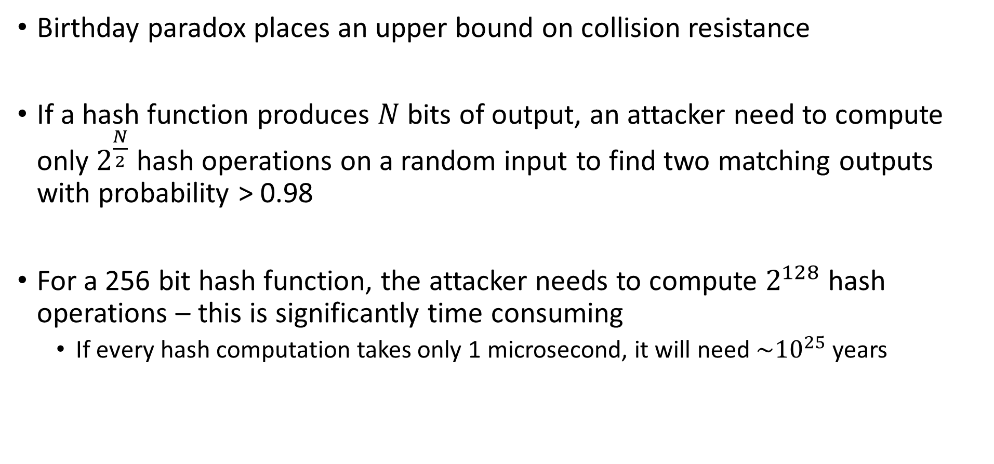
Collision Free – How Do We Guarantee
Birthday paradox places an upper bound on collision resistance
If a hash function produces $N$ bits of output, an attacker need to compute only $2^{\frac{N}{2}}$ hash operations on a random input to find two matching outputs with probability > 0.98
For a 256 bit hash function, the attacker needs to compute $2^{128}$ hash operations – this is significantly time consuming
If every hash computation takes only 1 microsecond, it will need ${\sim 10}^{25}$ years

Slide 8
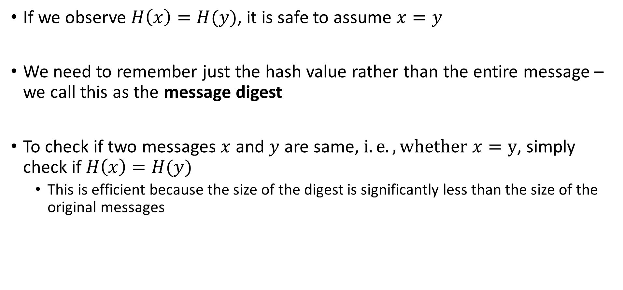
Hash as A Message Digest
If we observe $H\left(x\right)=H(y)$, it is safe to assume $x=y$
We need to remember just the hash value rather than the entire message – we call this as the message digest
To check if two messages $x$ and $y$ are same, $i.e., whether x=y$, simply check if $H\left(x\right)=H(y)$
This is efficient because the size of the digest is significantly less than the size of the original messages

Slide 9
Hashing - Illustration
http://www.blockchain-basics.com/HashFunctions.html
Courtesy: Blockchain Basics: A Non-Technical Introduction in 25 Steps by Daniel Drescher

Slide 10
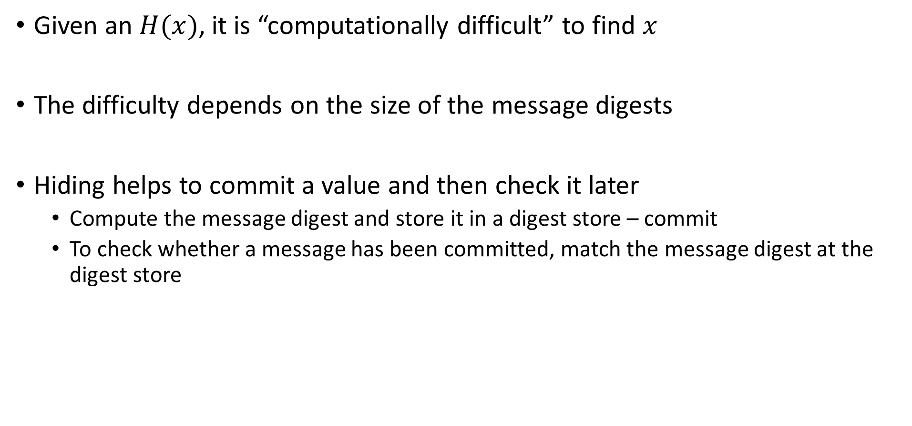
Information Hiding through Hash
Given an $H(x)$, it is “computationally difficult” to find $x$
The difficulty depends on the size of the message digests
Hiding helps to commit a value and then check it later
Compute the message digest and store it in a digest store – commit
To check whether a message has been committed, match the message digest at the digest store

Slide 11
Message Commitment through Multiple Parties
Alice
Bob
Jane
H(M,K_{A}),M,K_{A}
H(M,K_{A}),M,K_{A}
Commit
Verify
Verify
K_{A} is the public key of Alice – A public identity that only Alice can have

Slide 12
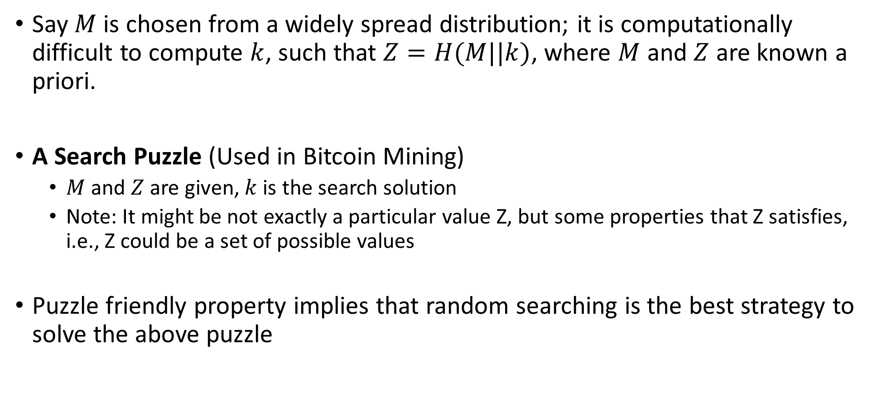
Puzzle Friendly
Say $M$ is chosen from a widely spread distribution; it is computationally difficult to compute $k$, such that $Z=H(M||k)$, where $M$ and $Z$ are known a priori.
A Search Puzzle (Used in Bitcoin Mining)
$M$ and $Z$ are given, $k$ is the search solution
Note: It might be not exactly a particular value Z, but some properties that Z satisfies, i.e., Z could be a set of possible values
Puzzle friendly property implies that random searching is the best strategy to solve the above puzzle

Slide 13
Hash Function – SHA256
SHA256 is used in Bitcoin mining – to construct the Bitcoin blockchain
Secure Hash Algorithm (SHA) that generates 256 bit message digest
A part of SHA-2, a set of cryptographic hash functions designed by United States National Security Agency (NSA)

Slide 14
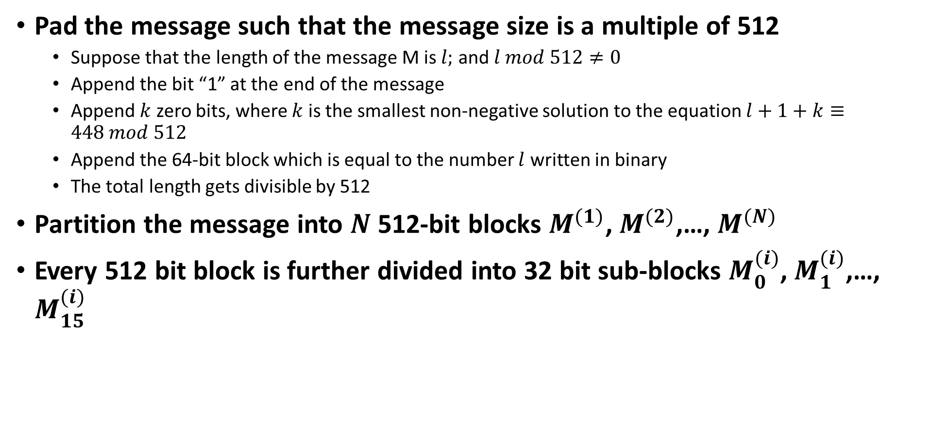
SHA256 Algorithm - Preprocessing
Pad the message such that the message size is a multiple of 512
Suppose that the length of the message M is $l;$ and $l mod 512≠0$
Append the bit “1” at the end of the message
Append $k$ zero bits, where $k$ is the smallest non-negative solution to the equation $l+1+k≡448 mod 512$
Append the 64-bit block which is equal to the number $l$ written in binary
The total length gets divisible by 512
Partition the message into $N$ 512-bit blocks $M^{(1)}$, $M^{(2)}$,…, $M^{(N)}$
Every 512 bit block is further divided into 32 bit sub-blocks $M_{0}^{(i)}$, $M_{1}^{(i)}$,…, $M_{15}^{(i)}$

Slide 15
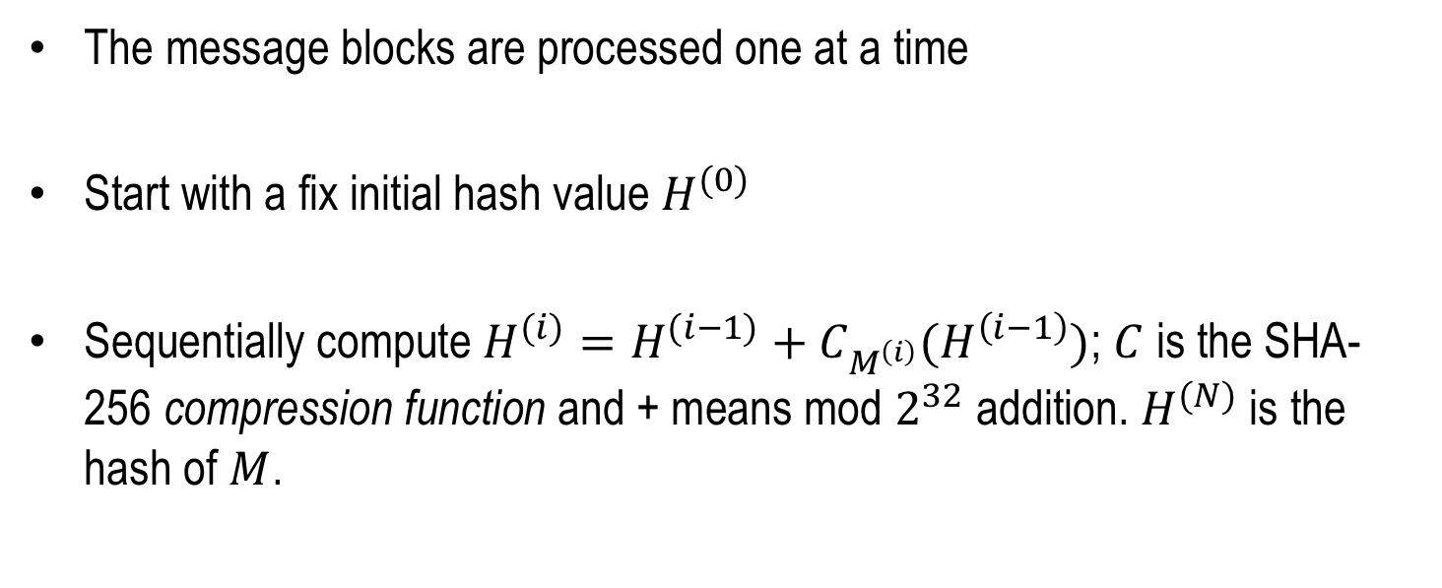
SHA-256 Algorithm
The message blocks are processed one at a time
Start with a fix initial hash value $H^{(0)}$
Sequentially compute $H^{(i)}=H^{(i−1)}+C_{M^{\left(i\right)}}(H^{\left(i−1\right)})$; $C$ is the SHA-256 compression function and + means mod $2^{32}$ addition. $H^{(N)}$ is the hash of $M$.

Slide 16
SHA-256 Algorithm
M⁽⁰⁾
M⁽¹⁾
M^{(N)}
Message Digest
C
C
C
256 bit Initialization Vector

Slide 17
Patterns of Hashing Data
Independent hashing
Repeated hashing
Combined hashing
Sequential hashing
Hierarchical hashing
Courtesy: Blockchain Basics: A Non-Technical Introduction in 25 Steps by Daniel Drescher

Slide 18
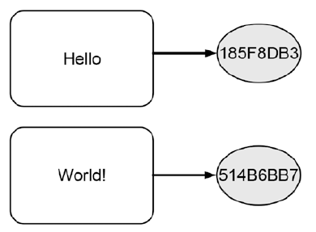
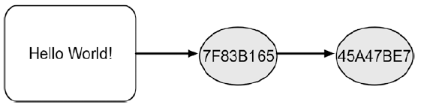
Types of Hashing
Independent hashing
Repeated hashing

Slide 19
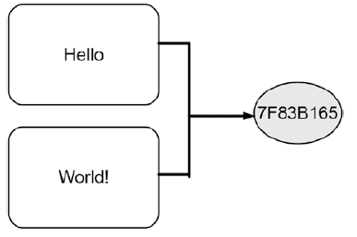
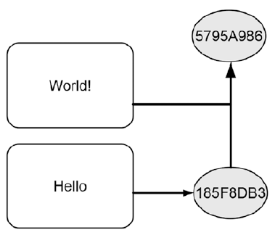
Types of Hashing
Combined hashing
Sequential hashing

Slide 20
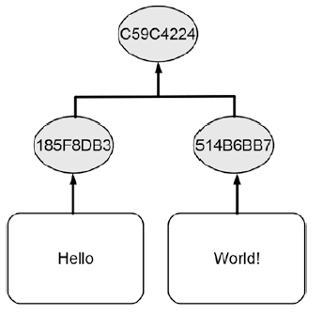
Types of Hashing
Hierarchical hashing

Slide 21
Hash Pointer
A Cryptographic Hash Pointer (Often called Hash Reference) is a pointer to a location where
Some information is stored
Hash of the information is stored
With the hash pointer, we can
Retrieve the information
Check that the information has not been modified (by computing the message digest and then matching the digest with the stored hash value)

Slide 22
Hash Pointer
H(DATA)
DATA
Hash Pointer
Reminds you of a linked list??
Reference: Coursera course on Bitcoin and Cryptocurrency Technologies

Slide 23
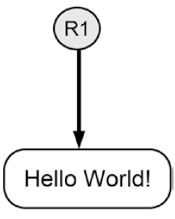

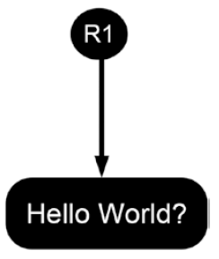
Tamper Detection using Hash Pointer
Courtesy: Blockchain Basics: A Non-Technical Introduction in 25 Steps by Daniel Drescher

Slide 24
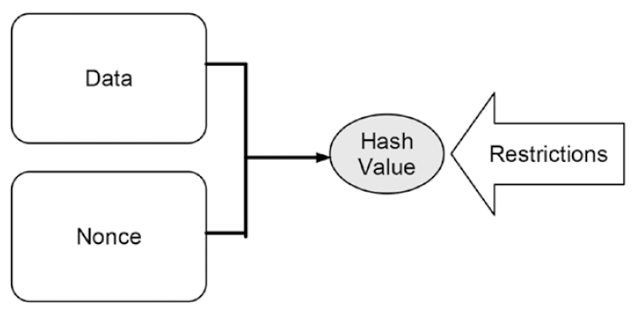
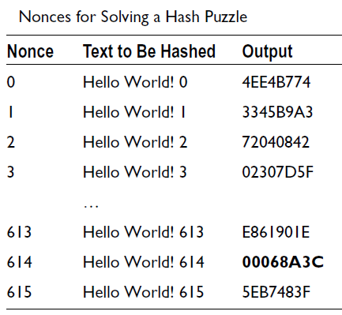
Making Tampering a Hash Chain Computationally Challenging
Courtesy: Blockchain Basics: A Non-Technical Introduction in 25 Steps by Daniel Drescher

Slide 25
Detect Tampering from Hash Pointers - Hashchain
H(D^{(i-1)})
H(D^{(i)})
H(D^{(i+1)})
D^{(i)}
D^{(i+1)}
D^{(i+2)}

Slide 26
Merkle Tree – Organization of Hash Pointers in a Tree
Root Hash
H_{root}=Hash(H₀+H₁)
Merkle Root
L₁ Hash
H₀= Hash(H₀₀+H₀₁)
L₁ Hash
H₁=Hash(H₁₀+H₁₁)
L₂ Hash
H₀₀=Hash(T₁)
L₂ Hash
H₀₁=Hash(T₂)
L₂ Hash
H₁₀=Hash(T₃)
L₂ Hash
H₁₁=Hash(T₄)
T₁
T₂
T₃
T₄

Slide 27
Blockchain as a Hashchain
Block Header
Block Header
Block Header
Previous Hash
Nonce
Previous Hash
Nonce
Previous Hash
Nonce
Merkle Root
Block Hash
Merkle Root
Block Hash
Merkle Root
Block Hash

